Slide 1
PYTHON PROJECT : (SPORTS MARTIAL ARTS CATEGORY REGISTRATION SYSTEM)
Present By : PUTERA NAQIB KHUSAIRI BIN ASRI (10DDT21F1021) MOHAMAD ALIFF BIN AZIZAN (10DDT21F1014)

Slide 2
TABLE OF CONTENTS
01
02
03
04
PROJECT REQUIEMENT
INTRODUCTION
CODING
OUTPUT

Slide 3
01
INTRODUCTION

Slide 4
INTRODUCTION
The Sports Martial Arts Category Registration System is a system that organizers can use to manage the registration process for Martial Arts competitions. Competitors can easily register using this system.

Slide 5
02
PROJECT REQUIEMENT

Slide 6
A
CODE

Slide 7
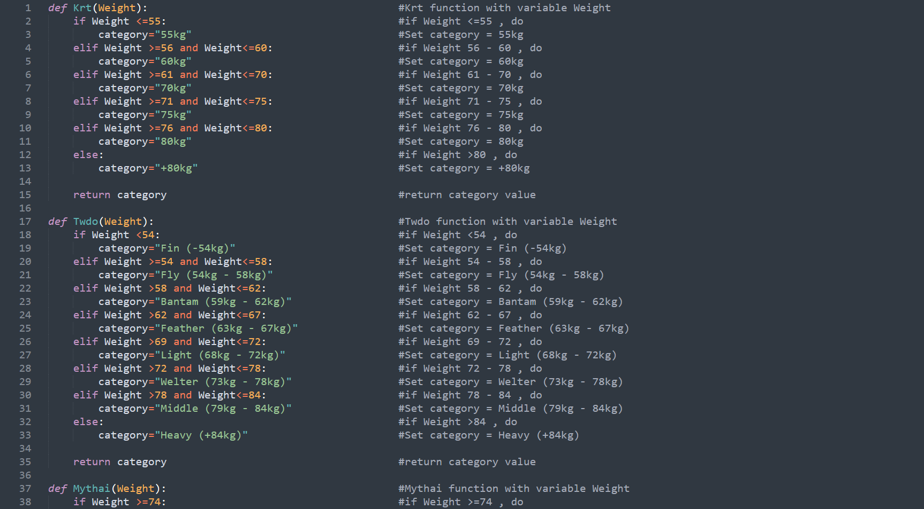
use Object-Oriented Python concept.
function()

Slide 8
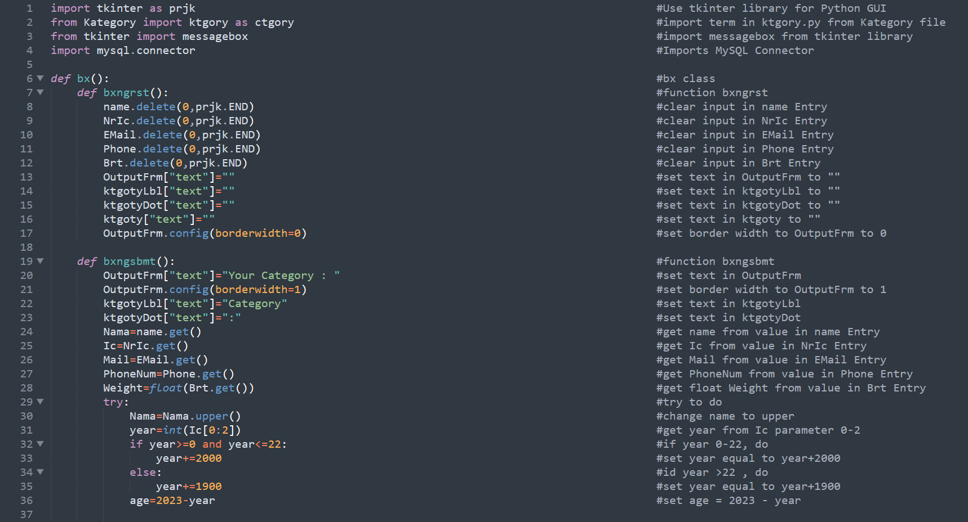
Import and use Modules.

Slide 9
Define the component of Object-Oriented Python at code
function()

Slide 10
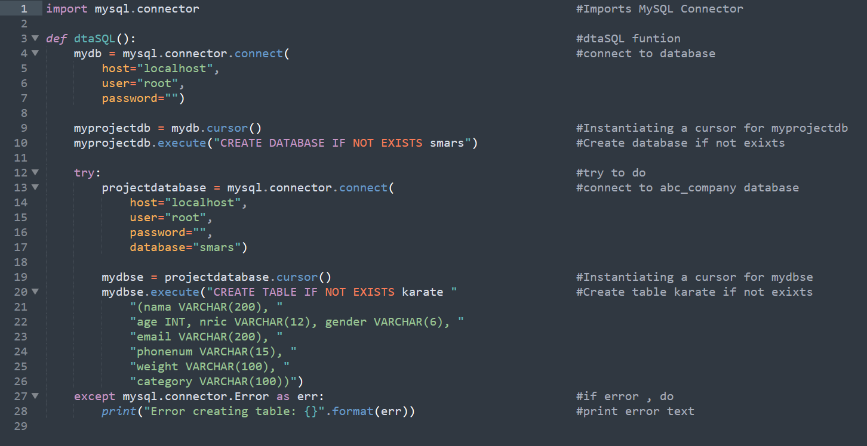
Provide comment for each code in the program

Slide 11
B
DIRECTORY HANDLING

Slide 12
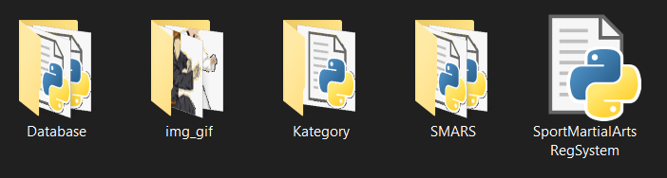
Get the content of a directory.

Slide 13
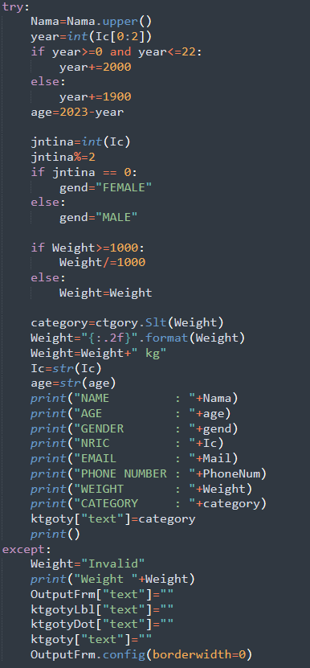
Use Raising Exception Handling concept.

Slide 14
C
GUI

Slide 15
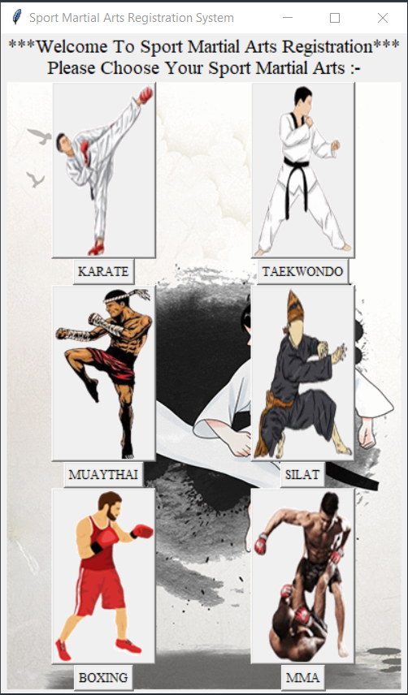
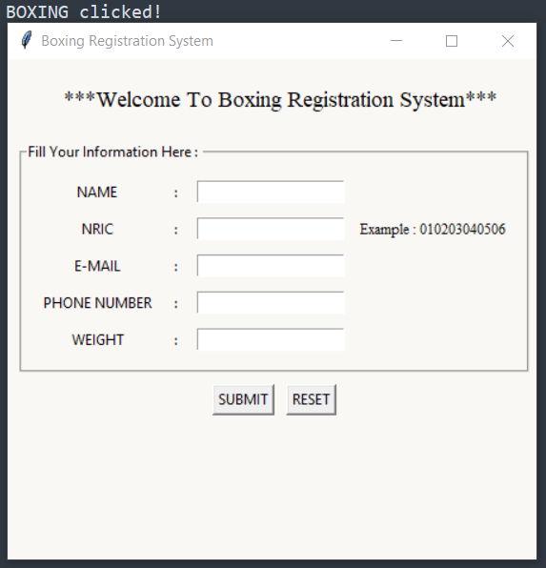
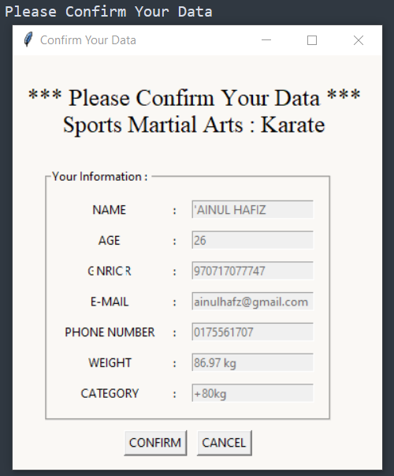
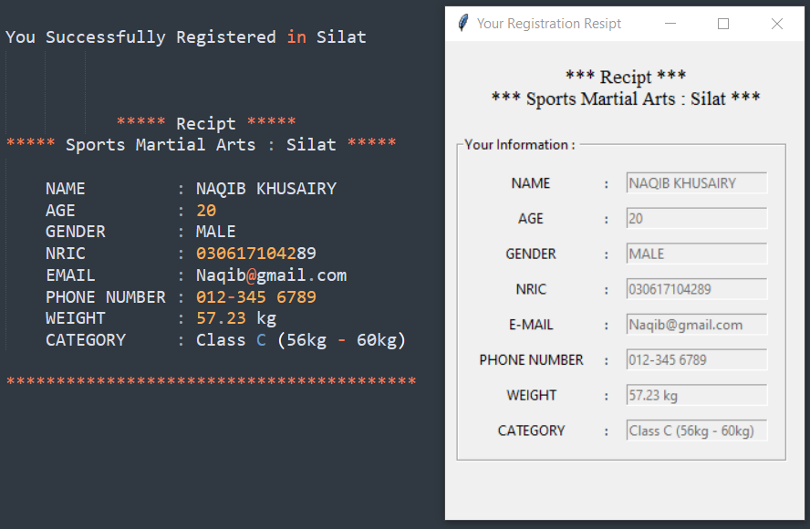
Windows, at least three windows

Slide 16
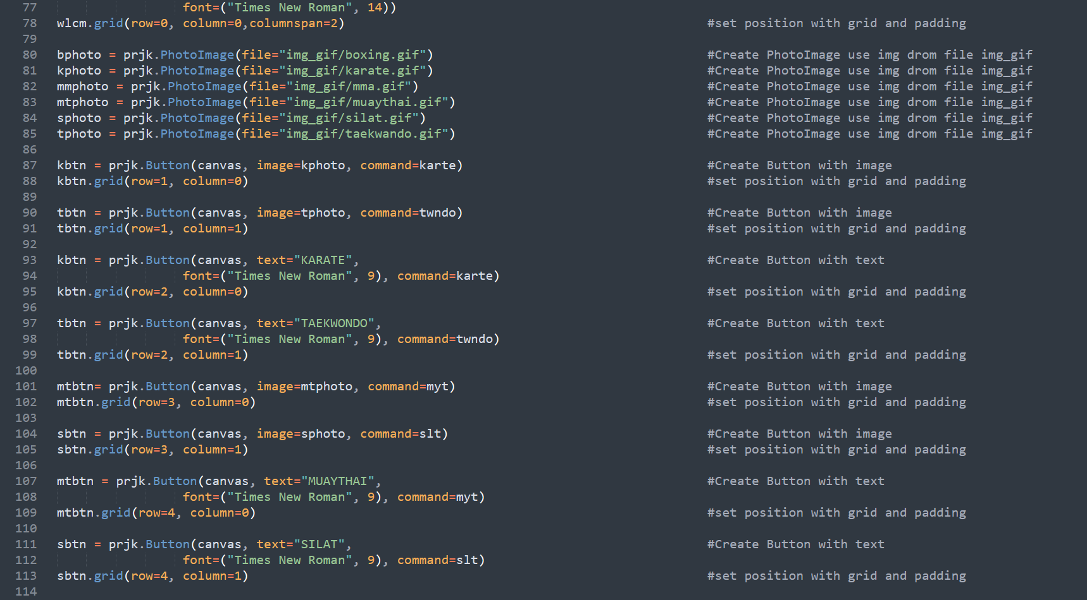
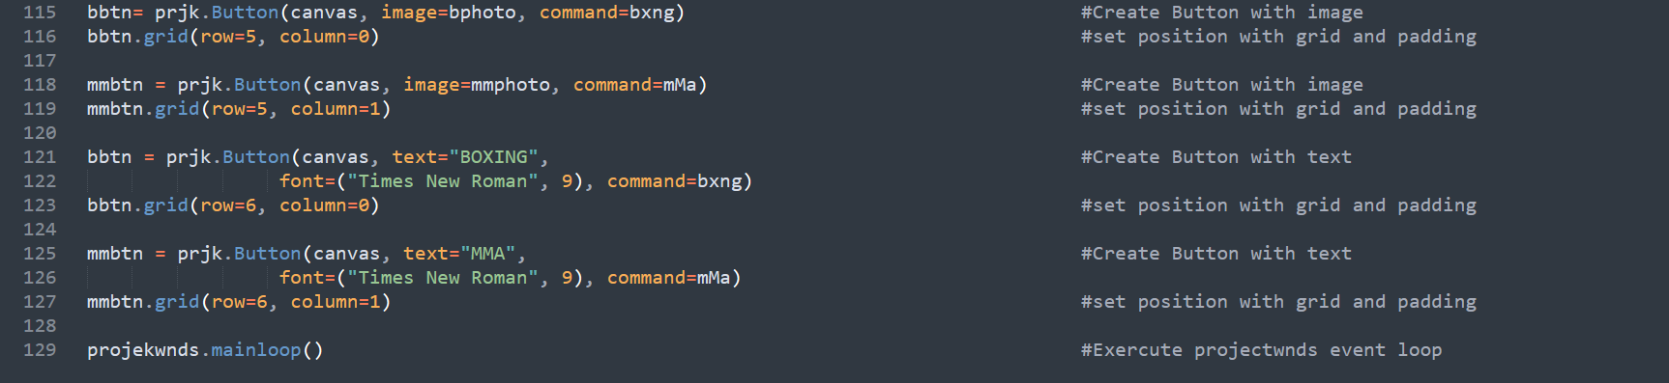
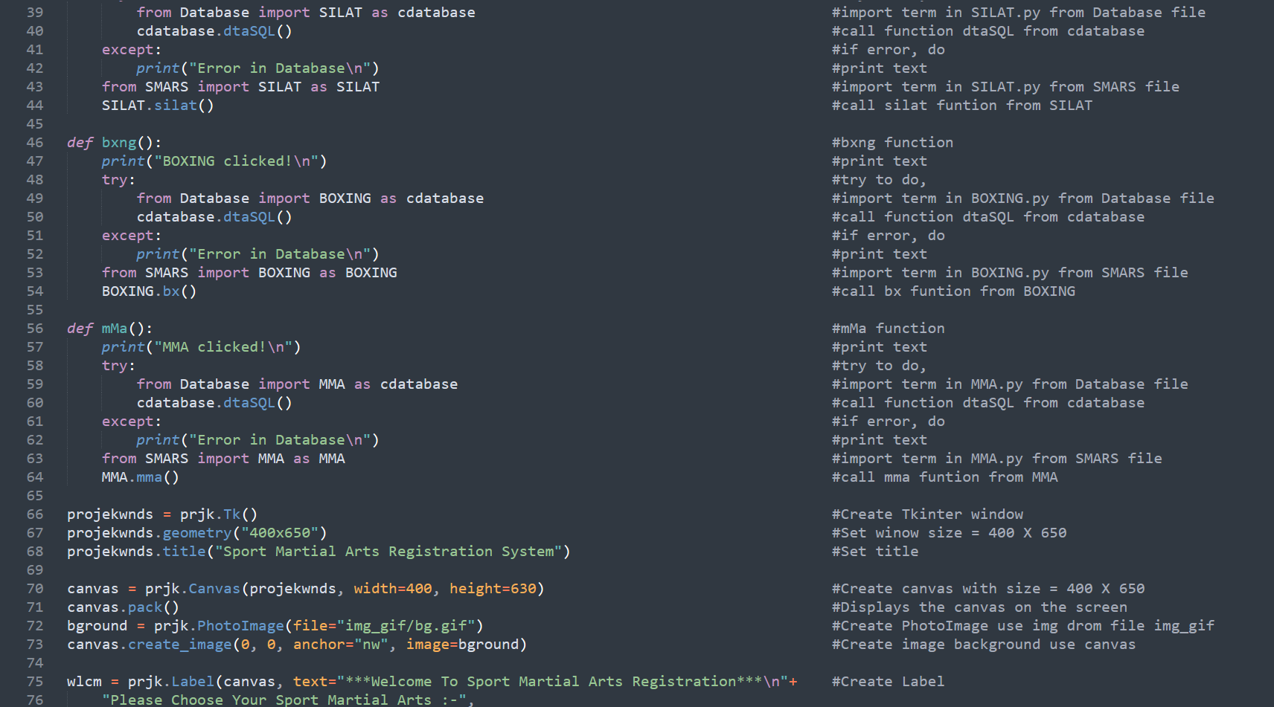
Implement e suitable GUI and event in graphical windows.

Slide 17
D
DATABASE

Slide 18
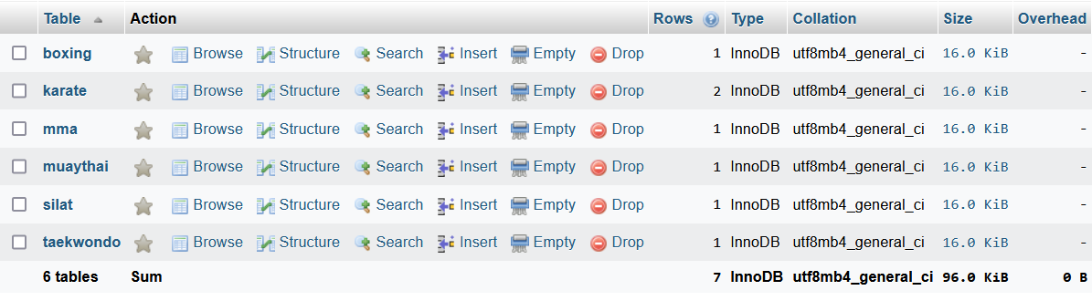
Content at least two tables in a database.

Slide 19
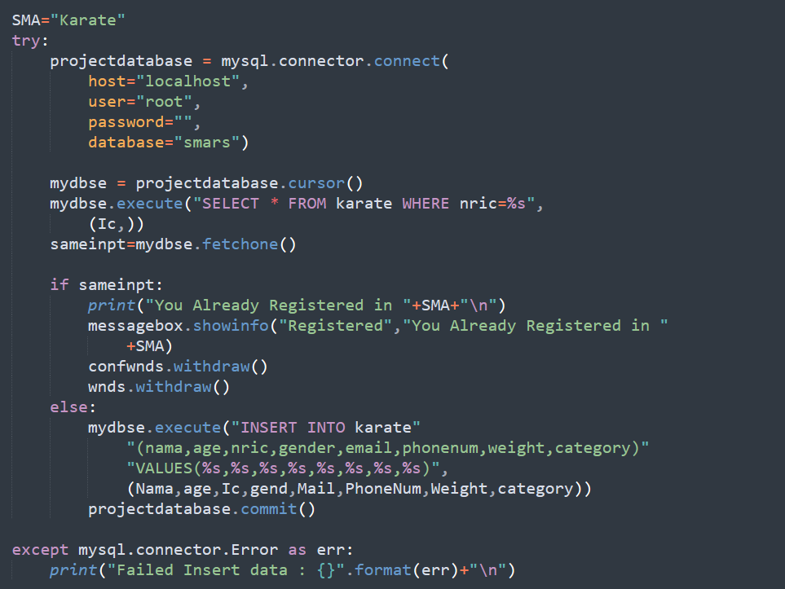
Basic requirement of database activity (Insert, Update, Delete and Select). Any SQL command to manipulate data like Search
Select
Insert

Slide 20
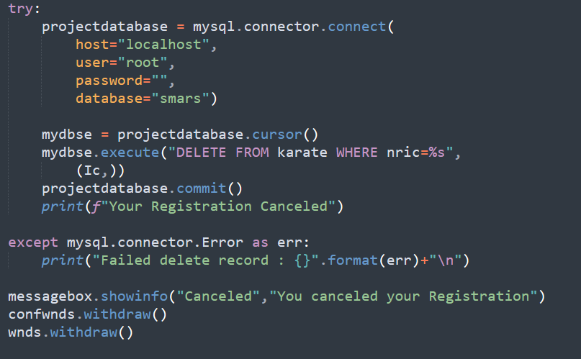
Basic requirement of database activity (Insert, Update, Delete and Select). Any SQL command to manipulate data like Search
Delete

Slide 21
E
OUTPUT

Slide 22
Must provide at least one receipt or report.

Slide 23
03
CODING

Slide 24
A
SportMartialArtsRegSystem.py

Slide 25
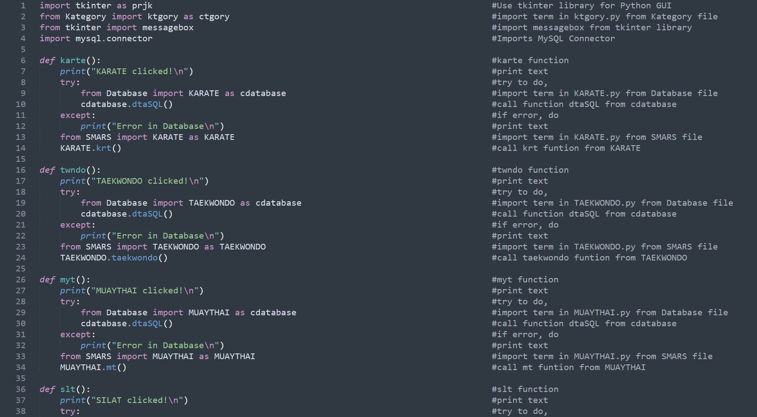

Slide 28
B
Kategory/Ktgory.py:

Slide 29
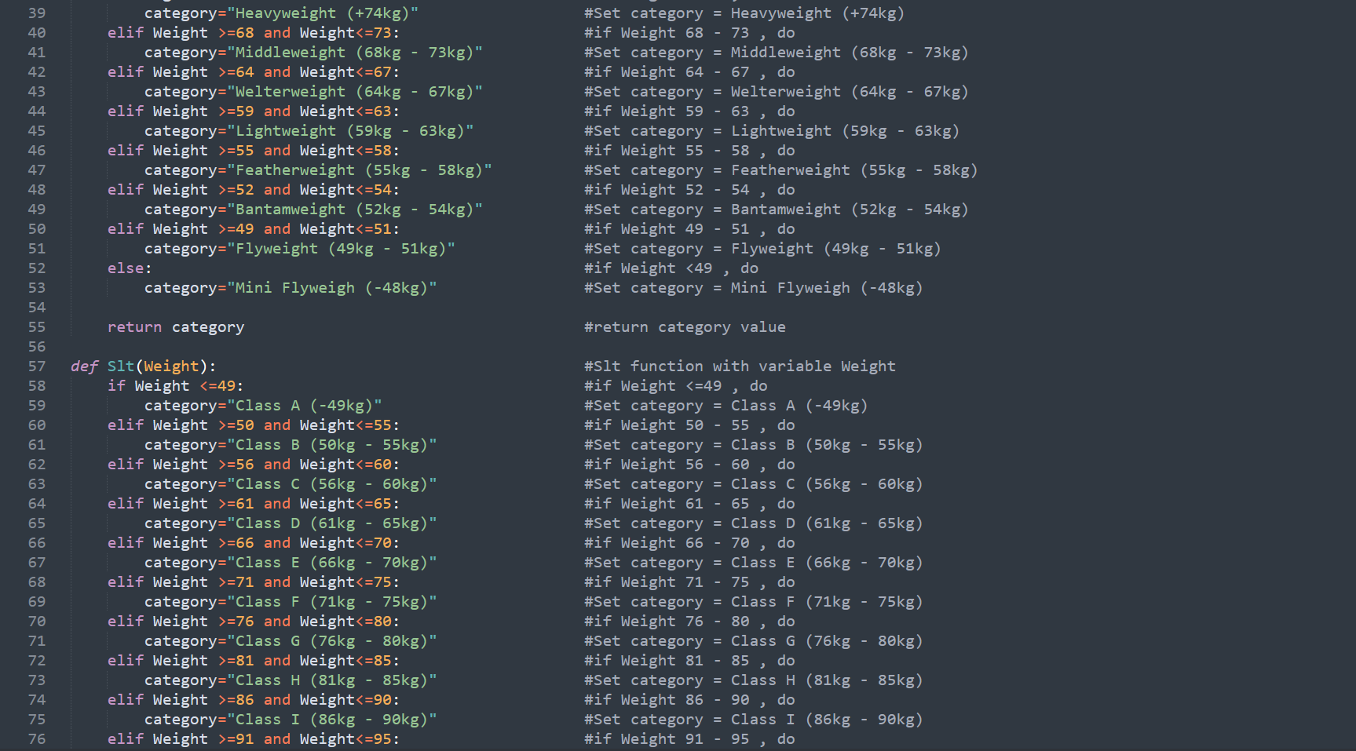

Slide 30
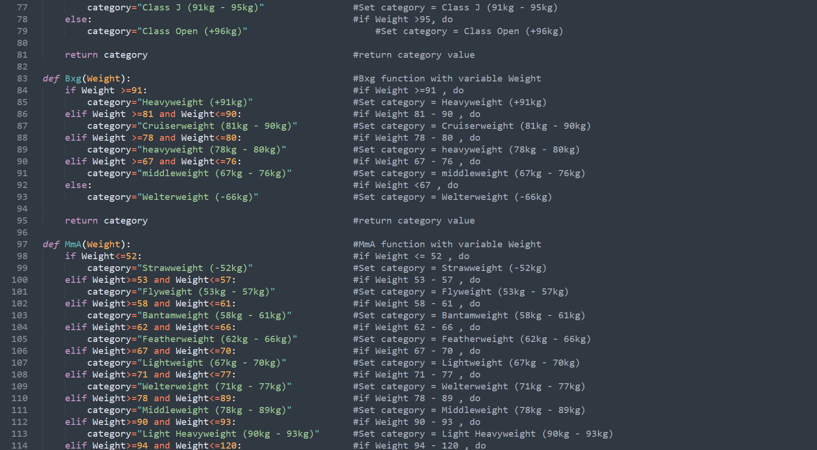

Slide 31
C
Database/ BOXING.py:

Slide 32
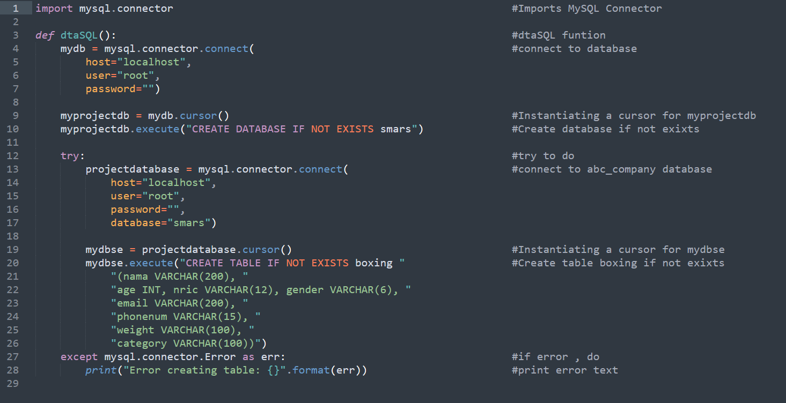

Slide 33
D
Database/ KARATE.py:

Slide 35
E
Database/ MMA.py:

Slide 36
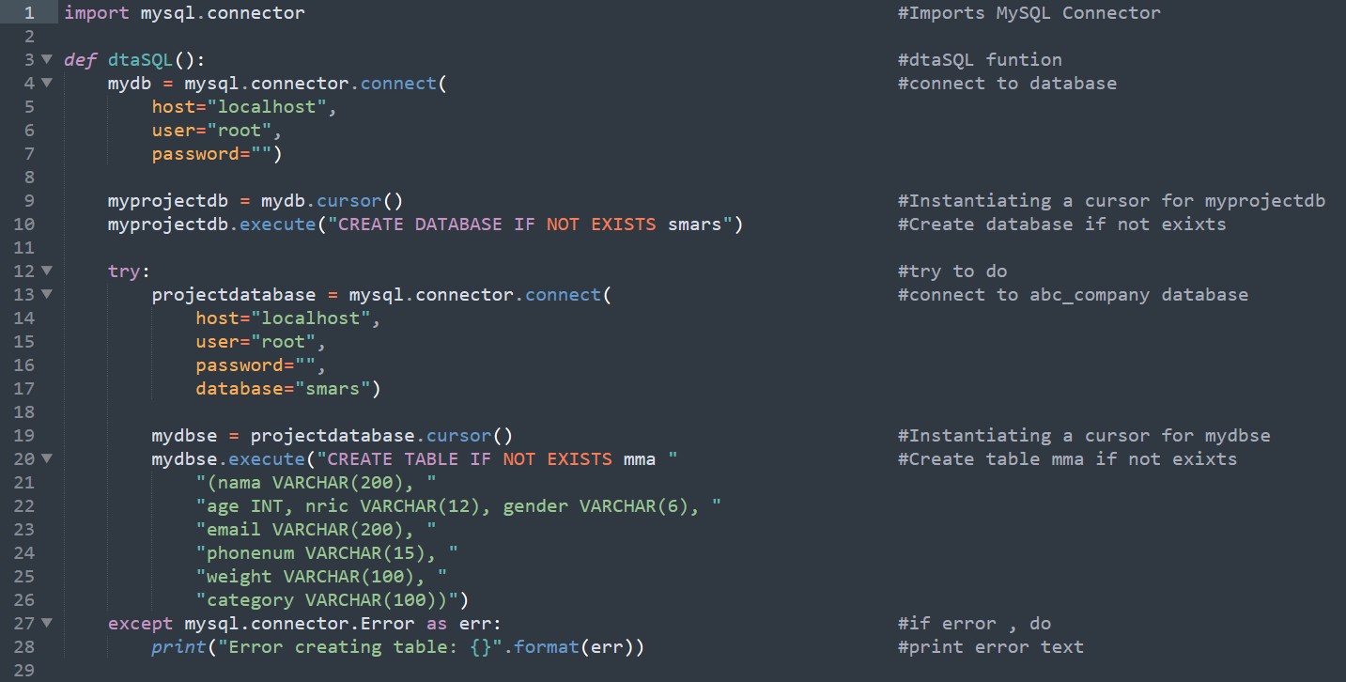

Slide 37
F
Database/ MUAYTHAI.py:

Slide 38
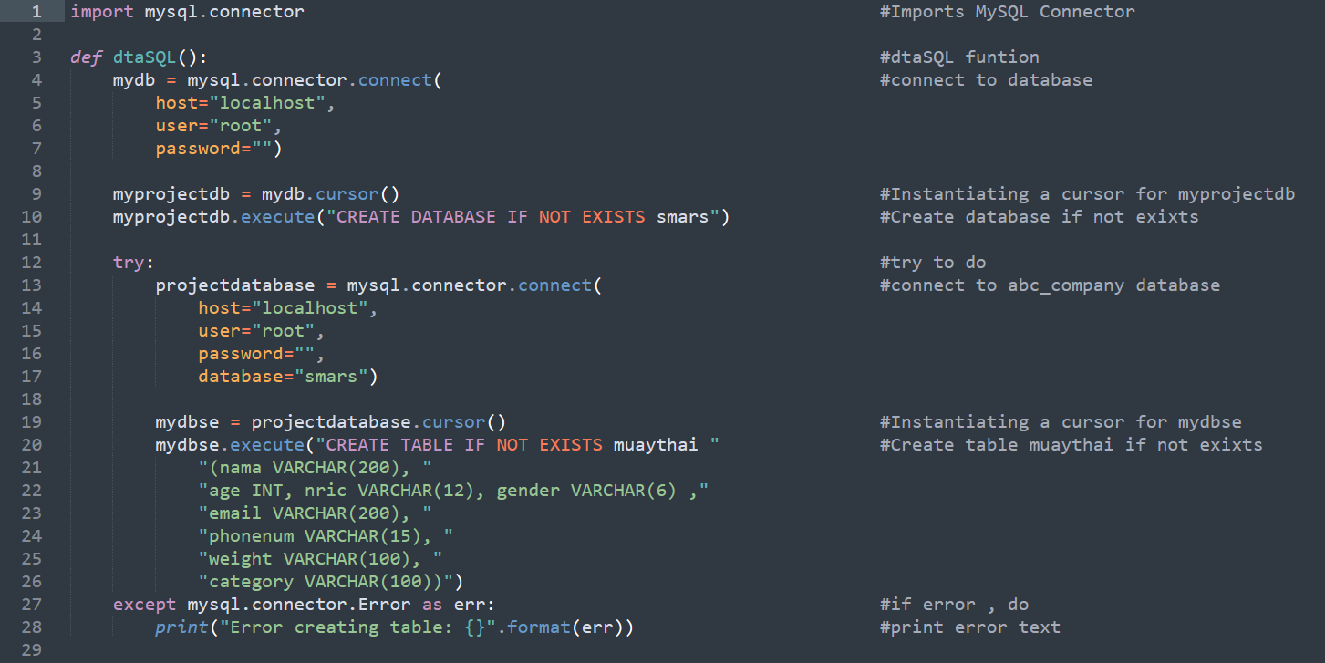

Slide 39
G
Database/ SILAT.py:

Slide 40
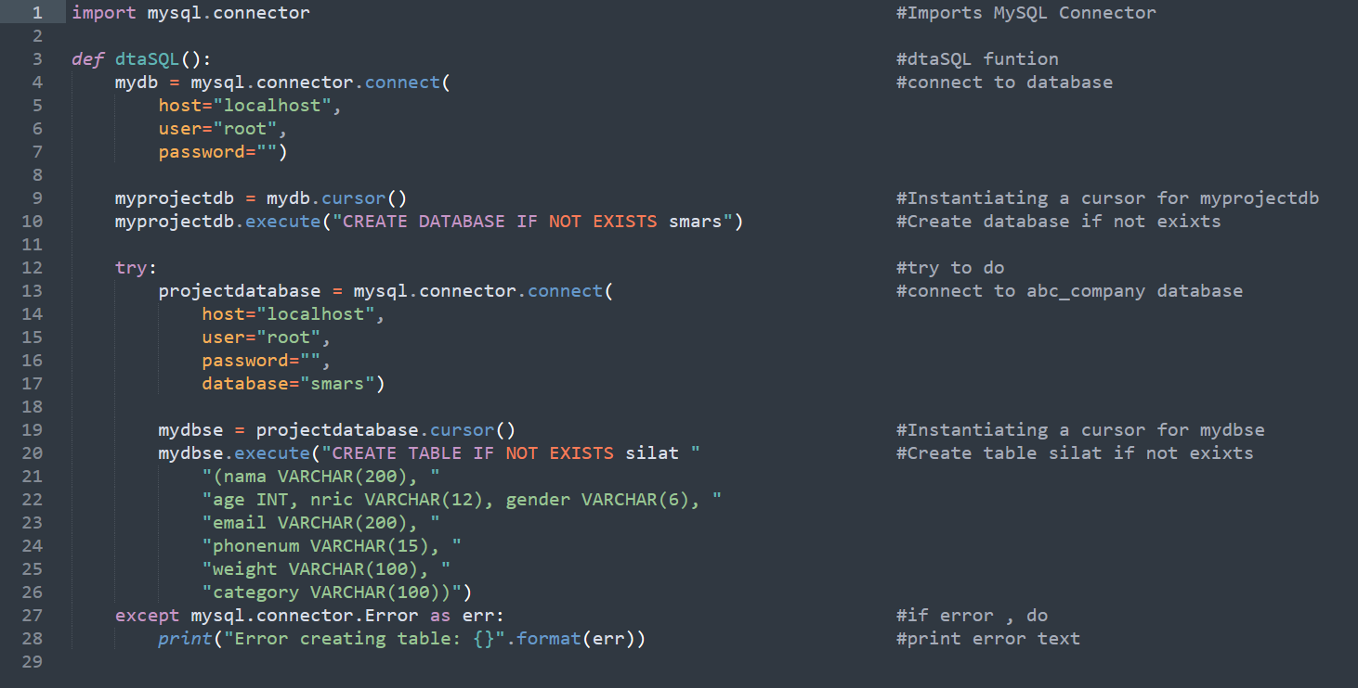

Slide 41
H
Database/ TAEKWONDO.py:

Slide 42
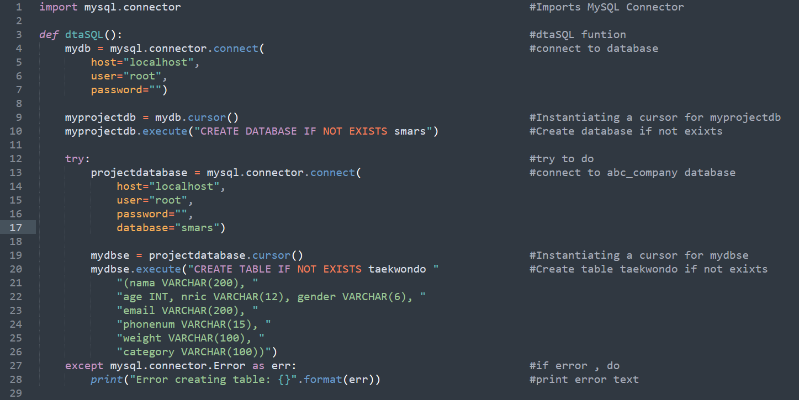

Slide 43
I
SMARS/ BOXING.py:

Slide 44
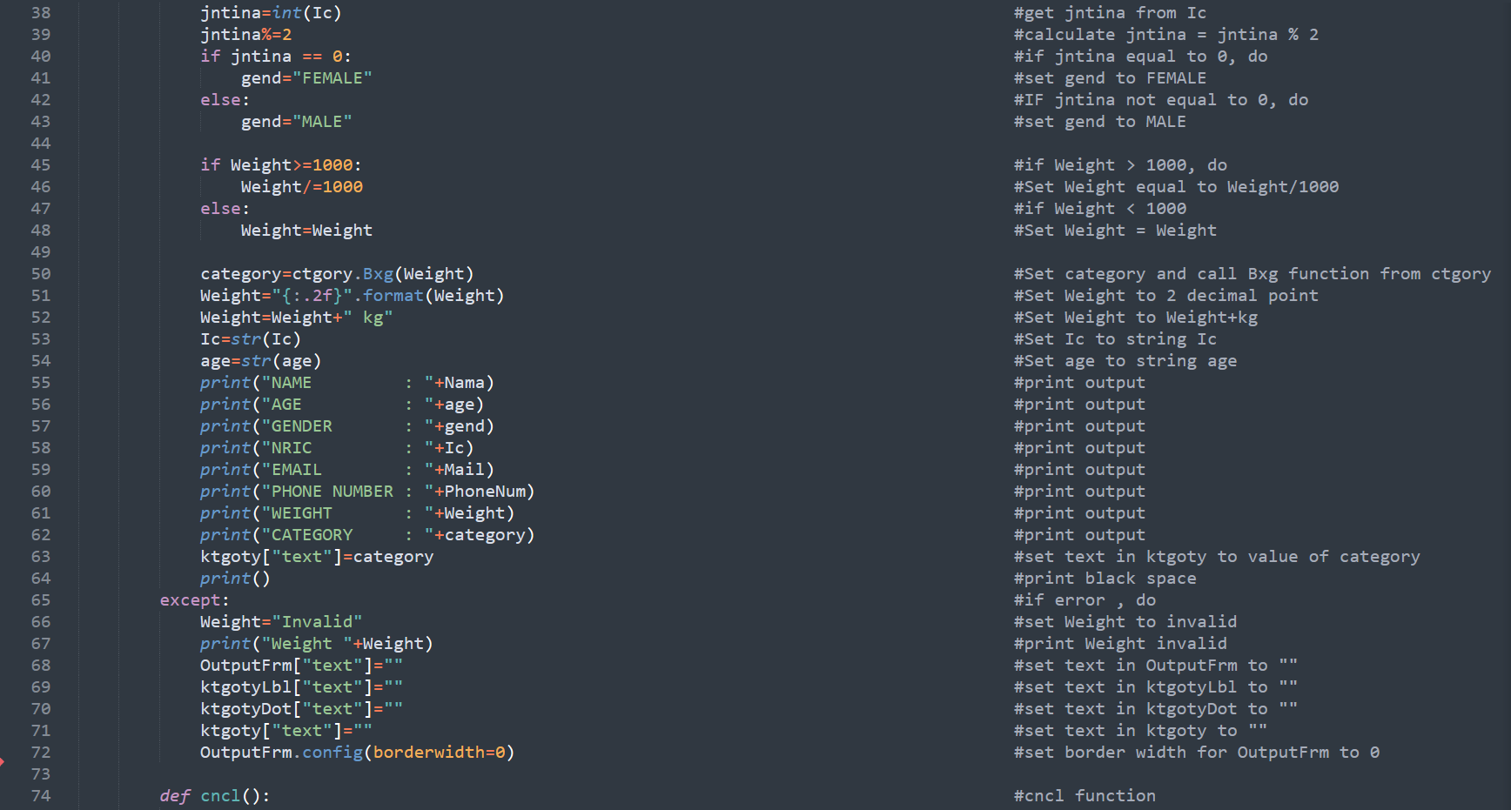

Slide 45

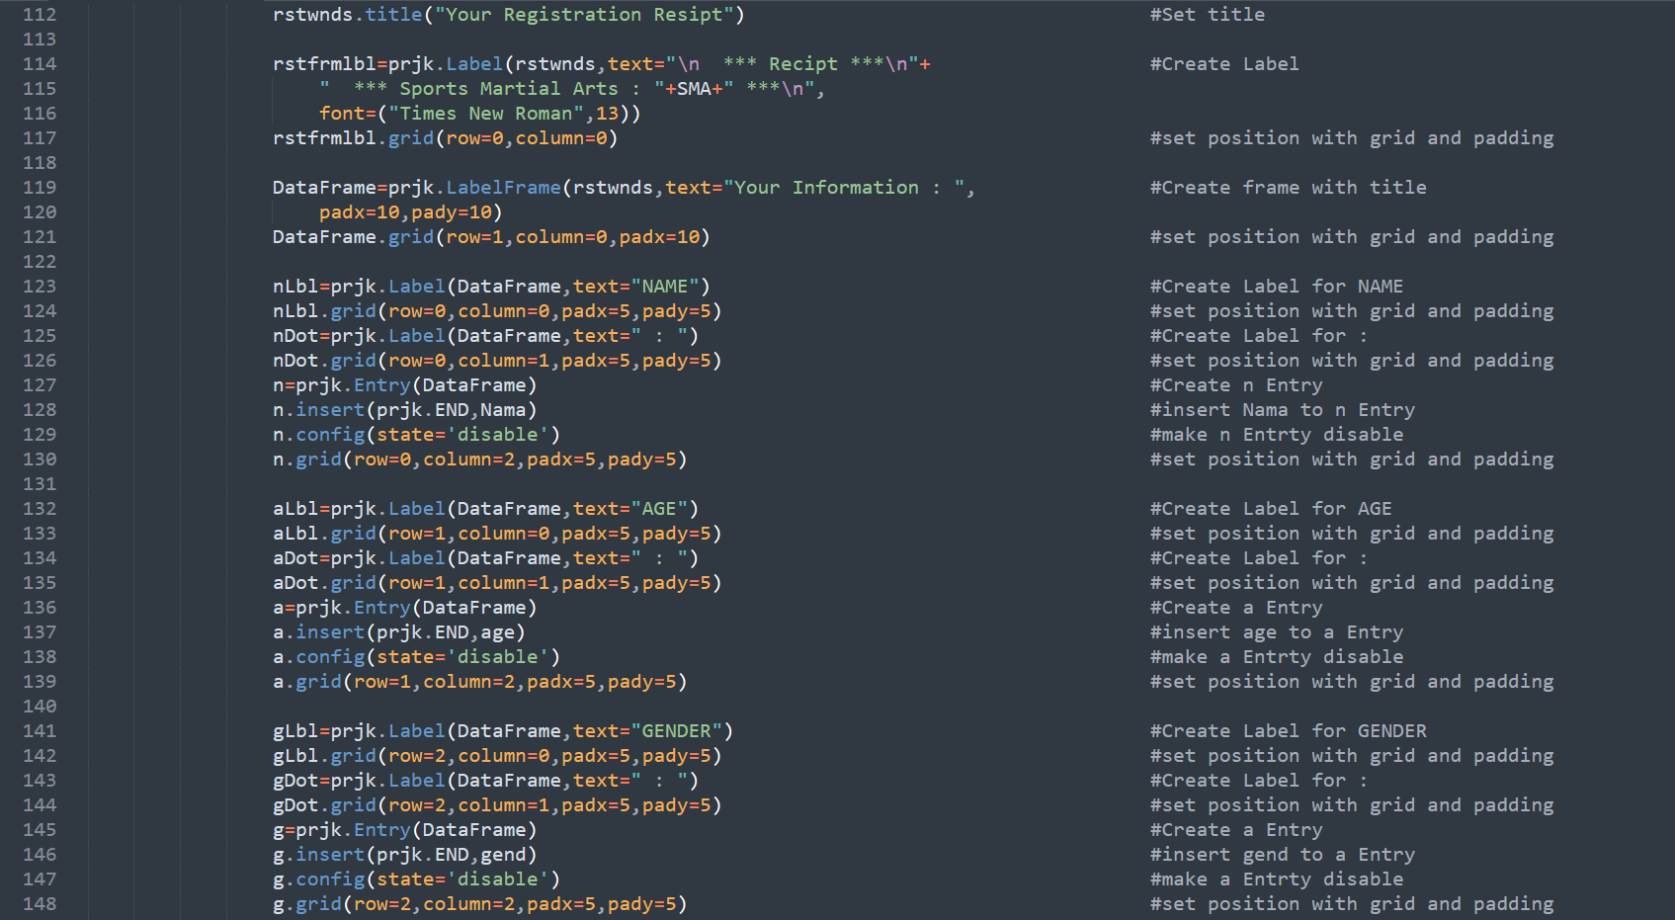

Slide 46
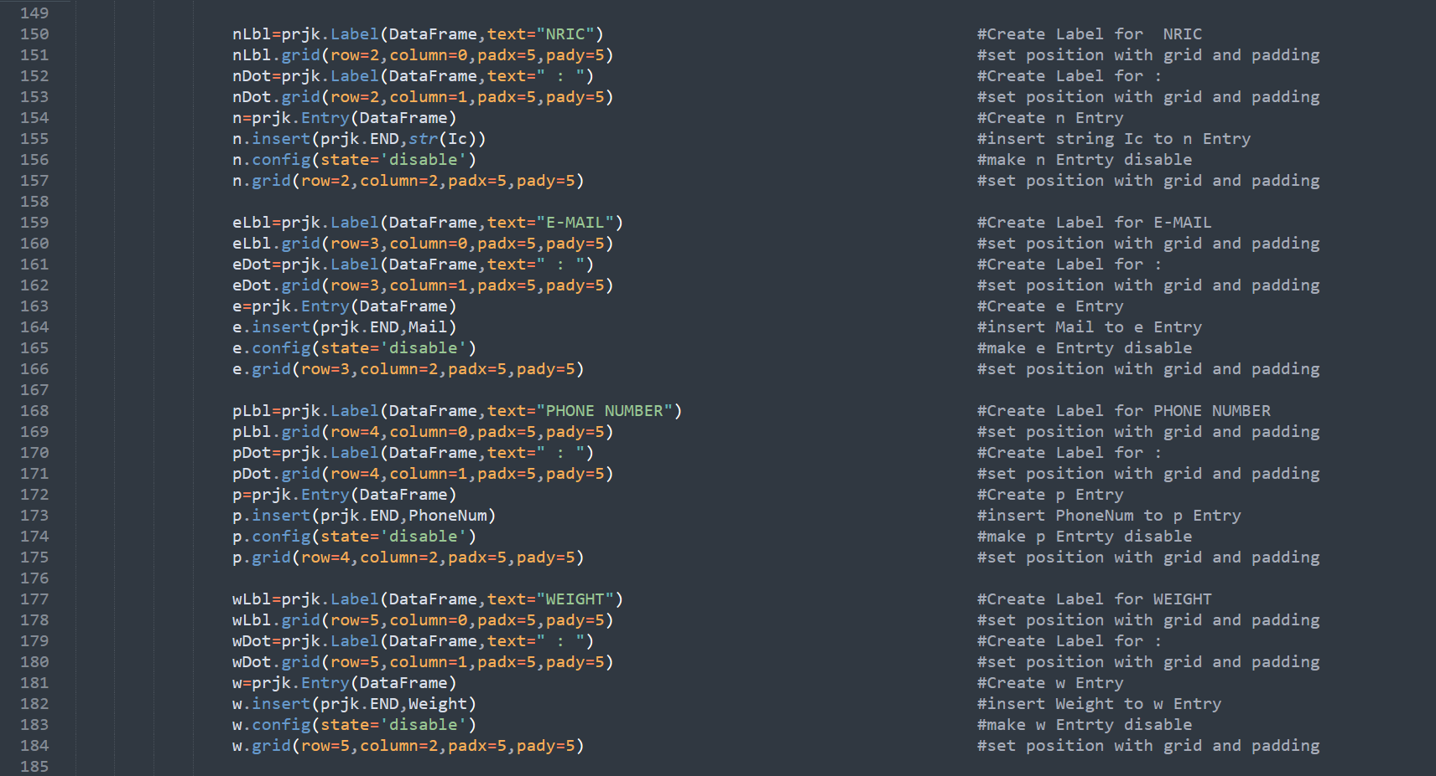

Slide 47
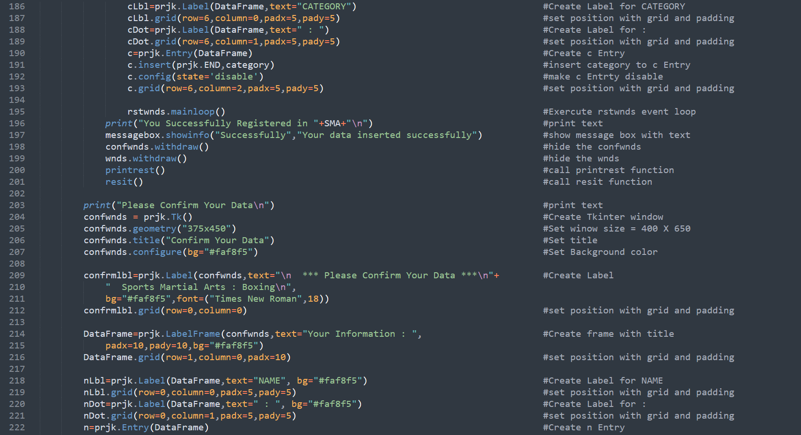
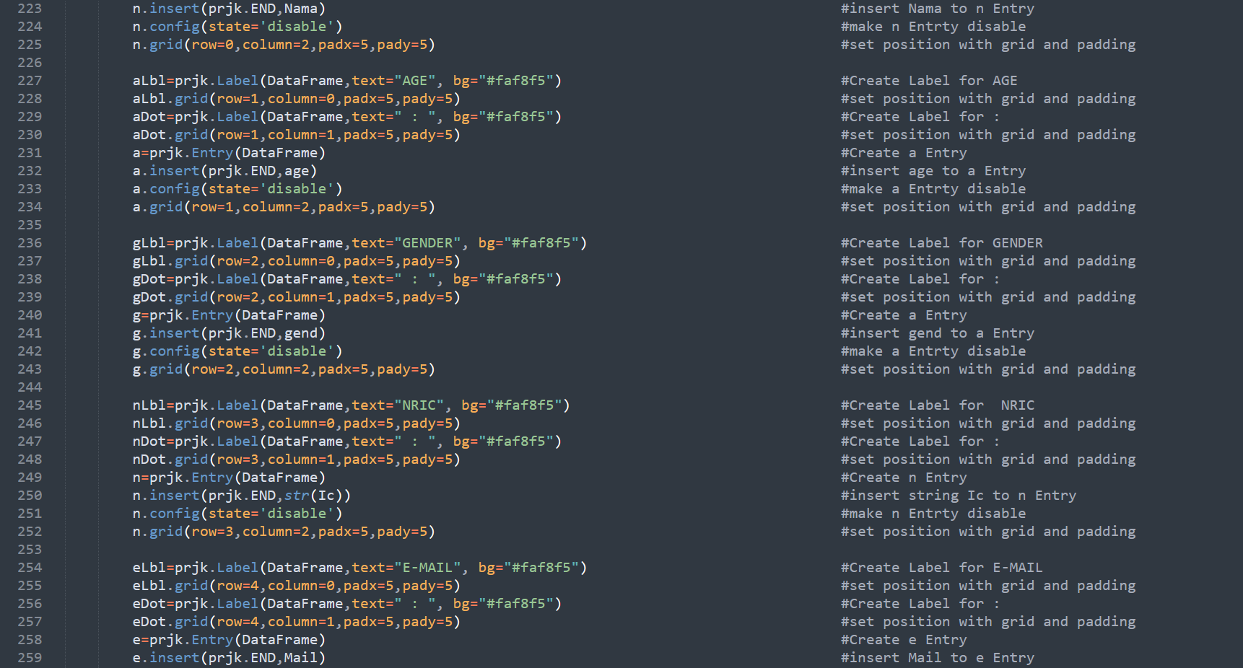

Slide 48
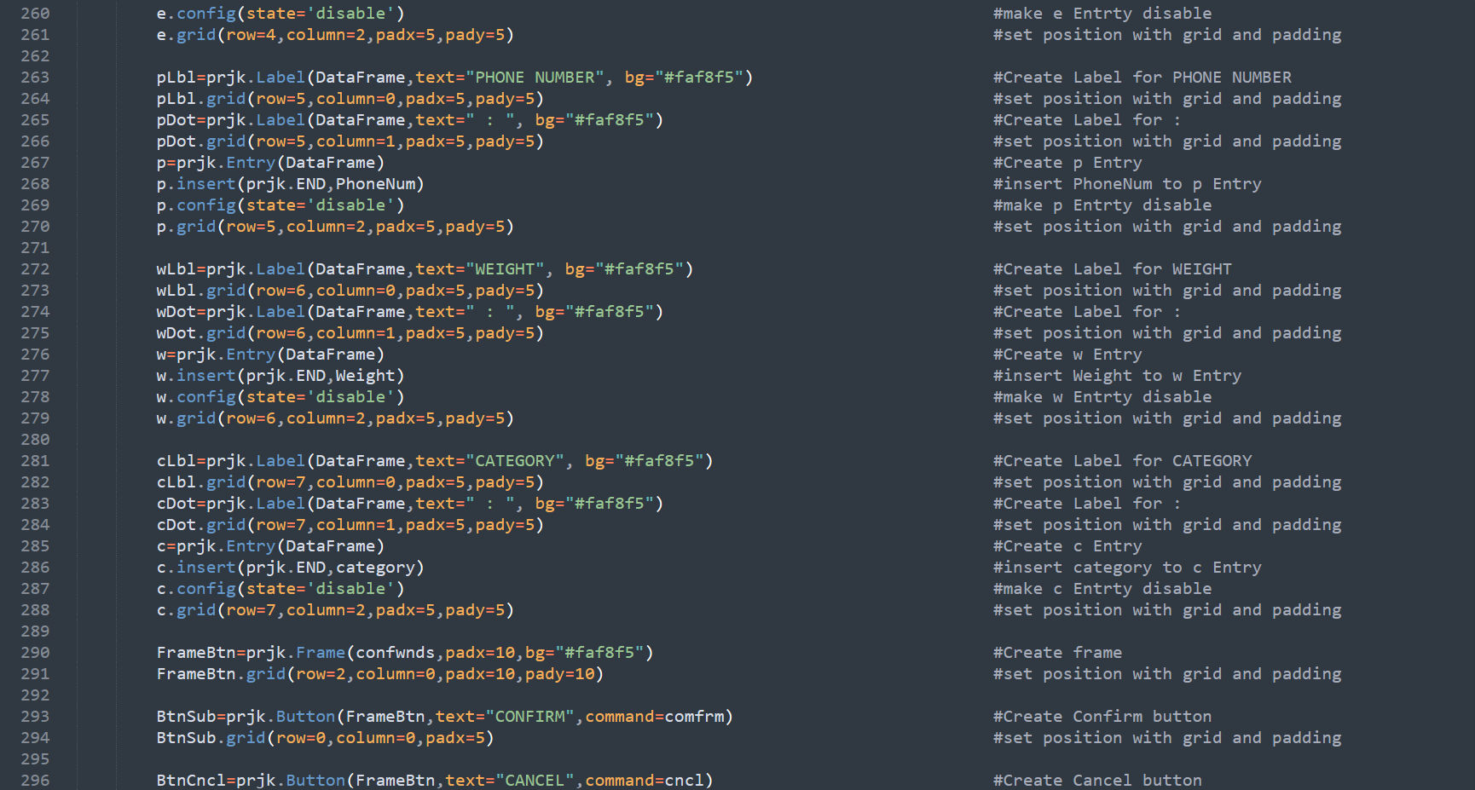

Slide 49
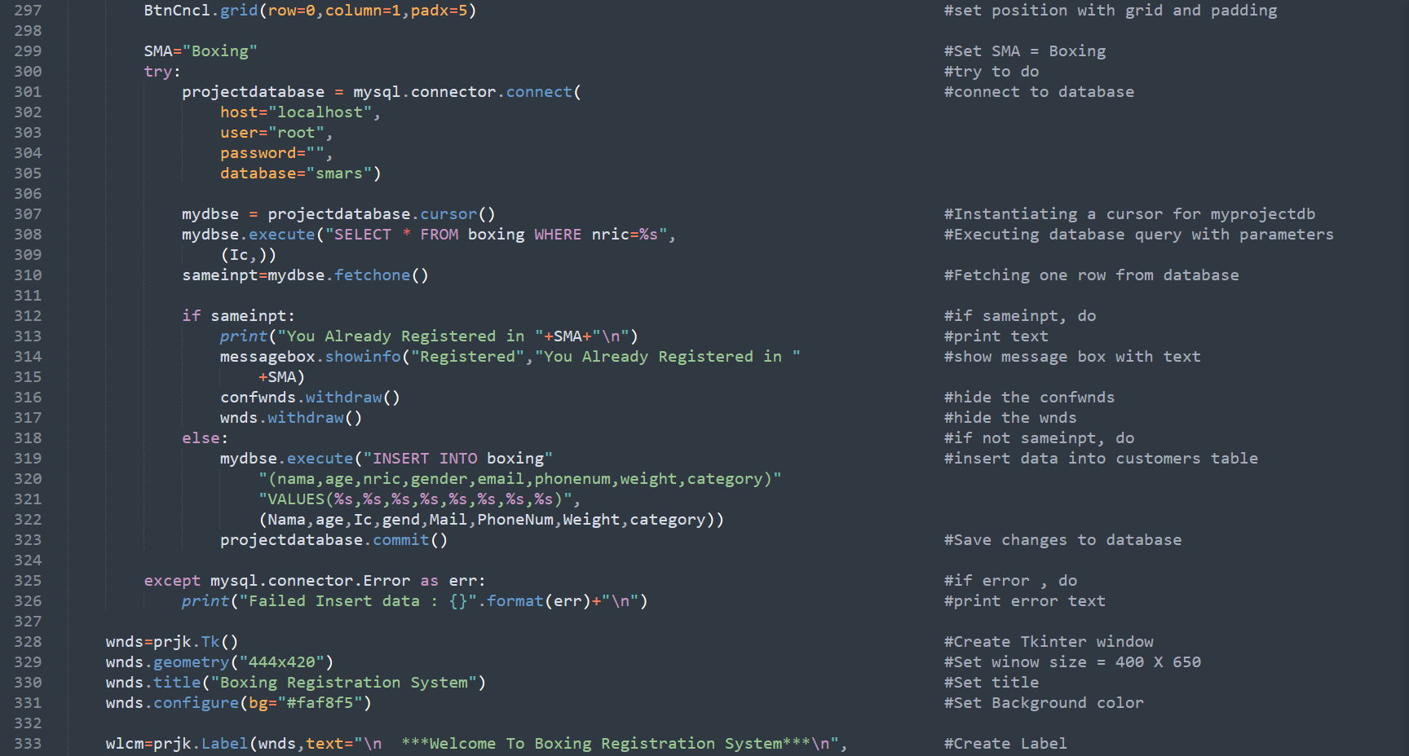

Slide 50
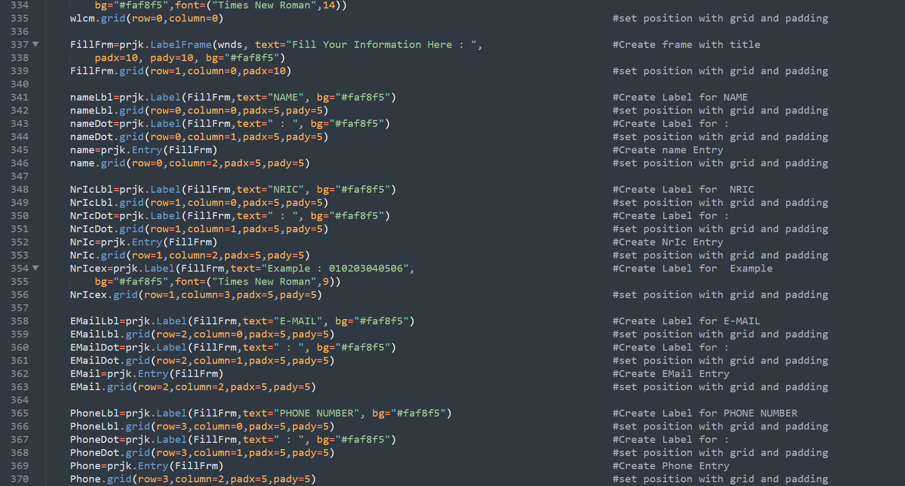

Slide 51
04
OUTPUT

Slide 53
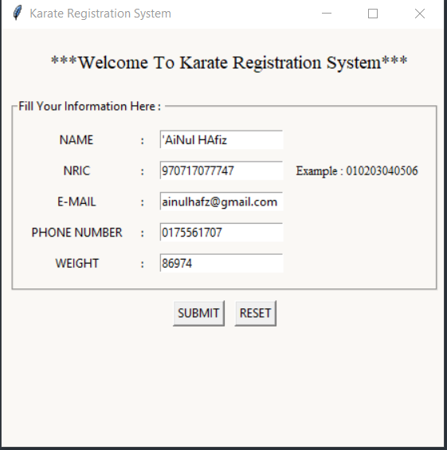
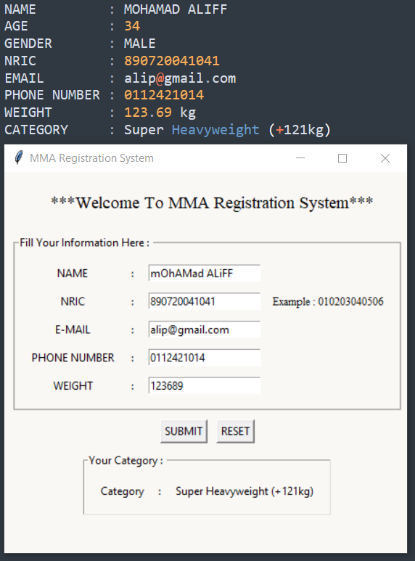
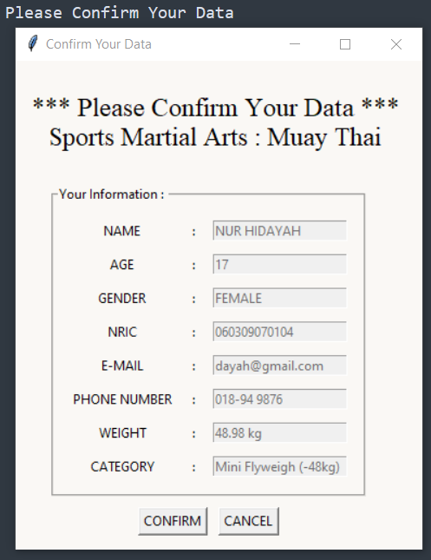
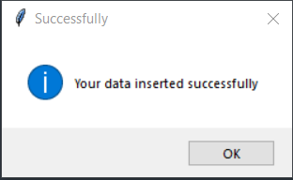

Slide 54
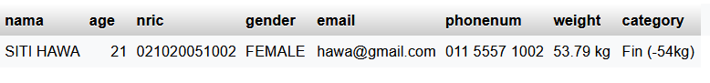

Slide 55
THANKS!

